Slide 1

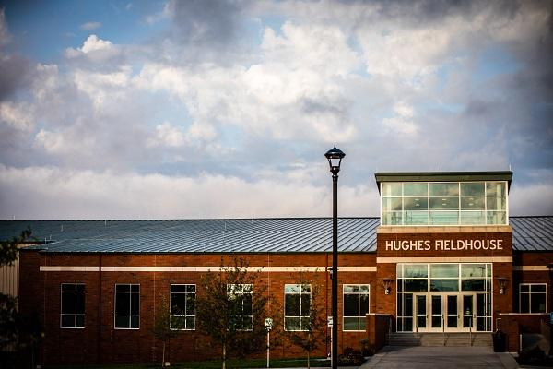
Brick Finder
Presented by:
Bhavika Padidala
Priyanka Bonam
Wendy Eloe
Sachin Setty
Subodh Bhargav Lakhinana
Durga Prasad Kallem
Photo credit: Todd Weddle

Slide 2
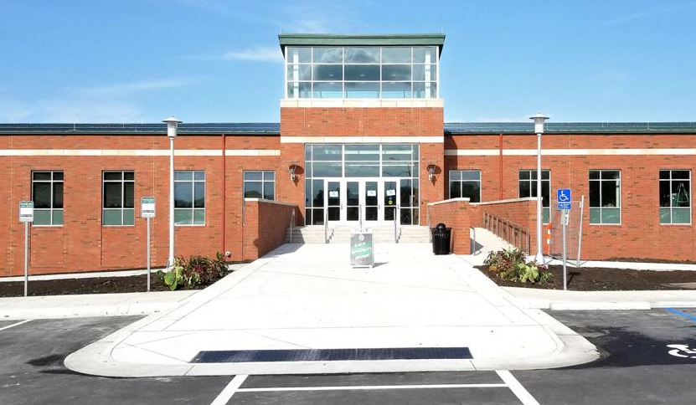
Brick Finder
Project Introduction and Motivation
Technologies Used
Demo
Search Algorithm
Major Challenges
Improvements Made in
GDP2
Questions
Photo credit: Todd Weddle

Slide 3
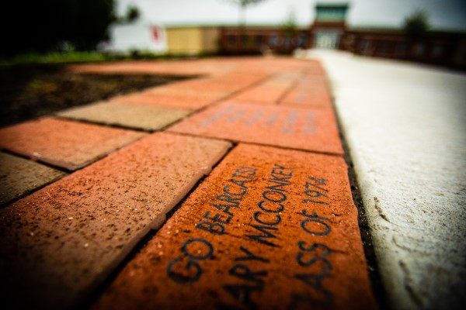
Project Introduction and Motivation
An easier way for people to find specific bricks on the Walk of Champions
Ability to read data directly from an Excel file
Create zones and maps
Search Donor Name and Inscription
Print a location map and the brick with inscription
Wendy Eloe
Photo credit: Todd Weddle

Slide 4
Technologies Used
Frontend:
HTML/CSS
JavaScript
JSON
AngularJS
Bootstrap
JQuery
SheetJS
Backend:
Excel
All of these technologies are supported by or built-in to modern web browsers.
Wendy Eloe

Slide 5
Repo link: https://github.com/wendycorene/bricks
Home page: https://wendycorene.github.io/bricks/search.html
Live mobile demo: http://wendycorene.github.io/bricks/
Priyanka Bonam & Bhavika Padidala
Notes:
http://wendycorene.github.io/bricks/ will redirect to the /search/search.html page automatically now

Slide 6
Search Algorithm
We converted the Excel data into JSON array to search the data
Improved our algorithm in a way that if user searches correct name it gives only their names.
If words are misspelled or swapped, we will print similar results
It checks in both donor name and personalization
It eliminates duplicate results
It won’t check if the search term shares 2 cells
https://github.com/wendycorene/bricks/blob/master/search.js
Priyanka Bonam

Slide 7
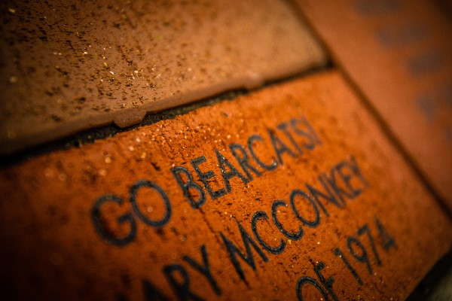
Major Challenges
Obtaining the search results.
Reading data from a multi-tabbed Excel sheet.
Implementing search functionality much more sophisticated.
Printing results in a table
Displaying the inscription
On image.
Identifying and fixing
test case issues.
Photo credit: Todd Weddle
Durga Prasad Kallem

Slide 8
Improvements Made in GDP2
Search functionality with special characters and minimum limit of 2 characters
Better UI for better performance
All Donors List
Link to purchase a brick
CSS in the brick display
Better map representation of zones
Sachin Setty

Slide 9
Questions & Feedback

